Slide 1
YouTube Ad Revenue Prediction
Content Monetization Modeler

Slide 2
Problem Statement
Predict ad revenue using video metrics
Identify key monetization drivers
Build & deploy ML model

Slide 3
Dataset Overview
120K+ records
Features: views, likes, comments, watch time, video length minutes, subscribers, ad revenue usd

Slide 4
Feature Engineering
Retention = watch_time / (views × video_length)
Engagement = (likes + comments) / views
Log transformation for subscribers

Slide 5
EDA Insights
Watch time strongest predictor (0.96)
Engagement & retention moderate
Feature | Correlation | Role
watch_time_minutes | 0.96 | Primary driver
retention_rate | 0.33 | Quality metric
engagement_rate | 0.15 | Interaction metric
likes | 0.14 | Supporting
comments | 0.03 | Supporting
views | 0.04 | Base metric

Slide 6
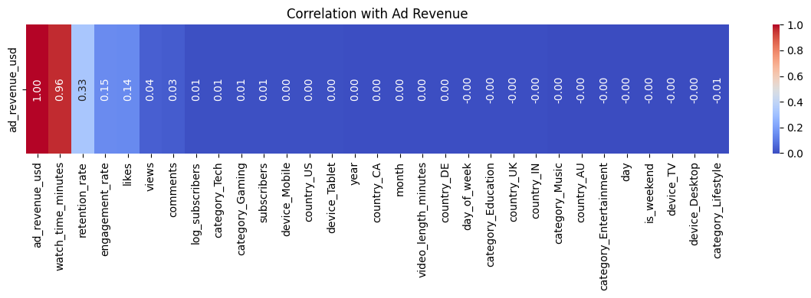
Correlation Heatmap

Slide 7
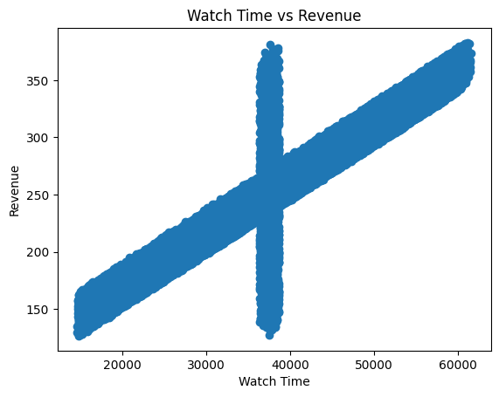
Watch Time vs Revenue

Slide 8
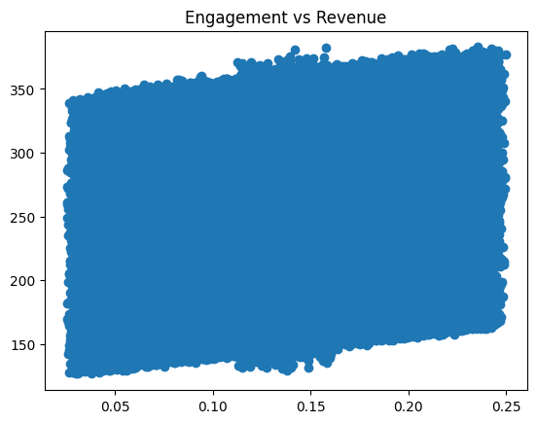
Engagement vs Revenue

Slide 9
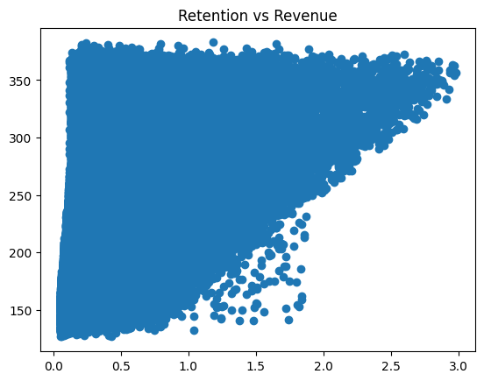
Retention vs Revenue

Slide 10
Model Comparison
Model | Train R² | Test R² | MAE | RMSE | Remarks
Linear Regression | 0.9497 | 0.95248 | 3.097 | 13.49
Ridge Regression | 0.9497 | 0.95248 | 3.094 | 13.49
Lasso Regression | 0.9497 | 0.95248 | 3.082 | 13.49 | Selected Model
Decision Tree | 1.00 | 0.898 | 5.72 | 19.76
Random Forest | 0.968 | 0.951 | 3.62 | 13.66

Slide 11
Why Lasso?
Lowest MAE
Simple & fast

Slide 12
Deployment
Streamlit app
User inputs → prediction
Real-time results

Slide 13
Conclusion
Watch time drives revenue
Simple models outperform complex ones

